Slide 1

Data Commander | IIT Roorkee
HACKATHON
#HumseFarakPadtaHai www.road-safety.co.in

Slide 2


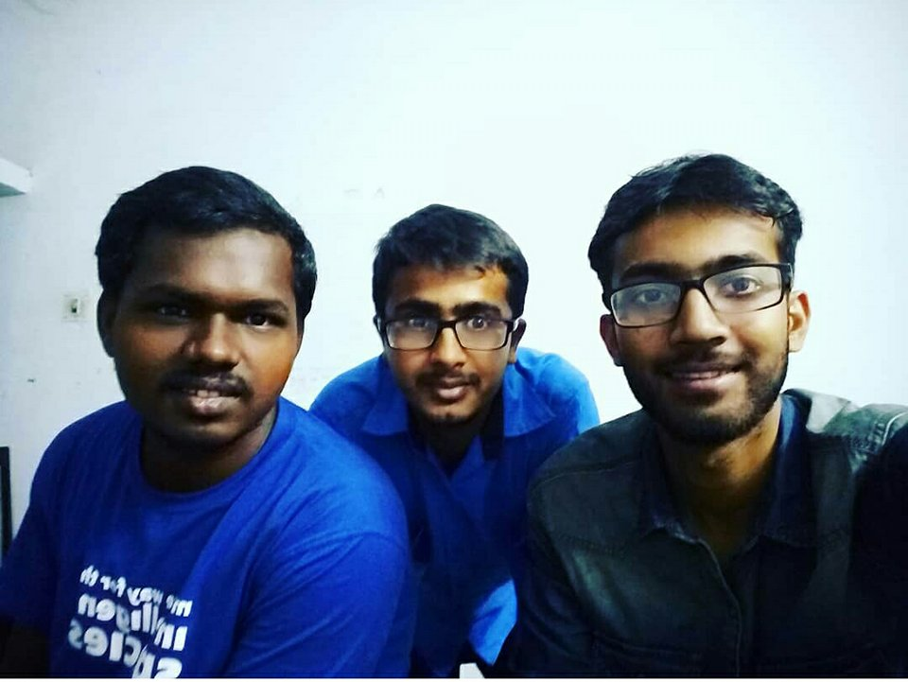
Data Commander
GROUP PHOTOGRAPH
Ritvik Raj
Ashwani Arya
Shubham Raut
#HumseFarakPadtaHai www.road-safety.co.in

Slide 3
Problem
Current solution to problem
Idea
Principles Involved
Demo
Major challenges Faced
Future Prospects
Your learning Experience and Conclusion
OVERVIEW | INDEX
#HumseFarakPadtaHai www.road-safety.co.in

Slide 4
Drowsiness Driving
Your eyelids droop and your head starts to nod. Yawning becomes almost constant and your vision seems blurry. You blink hard, focus your eyes and suddenly realize that you’ve veered onto the shoulder or into oncoming traffic for a moment and quickly straighten the wheel. This time you were lucky; next time you could become the latest victim of the tragedy of drowsy driving.
Drowsy driving, also referred to as ‘driver fatigue’, occurs when someone is too tired to operate a motor vehicle and, in turn, puts themselves, their passengers and other motorists in danger.
.
#HumseFarakPadtaHai www.road-safety.co.in

Slide 5
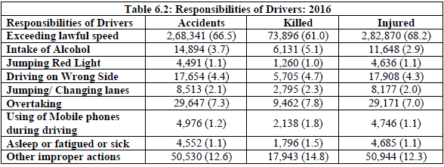
Drowsiness Driving
Why it’s important to solve it ?
Source : MINISTRY OF ROAD TRANSPORT & HIGHWAYS,TRANSPORT RESEARCH WING Report
#HumseFarakPadtaHai www.road-safety.co.in

Slide 6
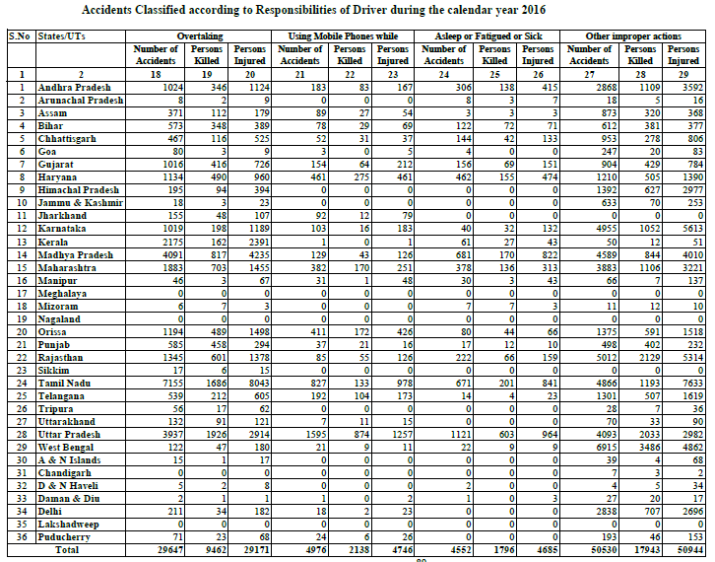
Drowsiness Driving
Source : MINISTRY OF ROAD TRANSPORT & HIGHWAYS,TRANSPORT RESEARCH WING Report
#HumseFarakPadtaHai www.road-safety.co.in

Slide 7
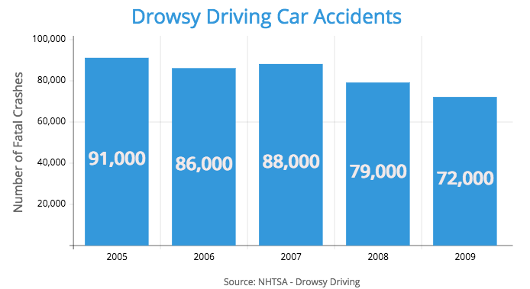
Drowsiness Driving
In America, From 2005-2009, drowsy driving accounted for approximately 1.4% of all car accidents.
But don't let the small percentage number fool you. That 1.4% represents 5,895,000 car accidents during those 5 years.
This means an average of 83,000 car accidents occurred every year due to drowsy driving.
In 2014, 846 people were killed in drowsy driver related car accidents. This accounted for 2.6% of all car accident fatalities in 2014.
Research has shown these figures to be consistent throughout the years.
From 2005-2009 an average of 1,004 people died every year (2.5% of all fatalities) from drowsy driver related car accidents.
#HumseFarakPadtaHai www.road-safety.co.in

Slide 8
Current Solutions
Solution
There are few laws against drowsy driving around the world, as drowsiness is often not measured or tested on the road.
Maggie’s Law – New Jersey, USA Probably the most well known drowsy driving law was passed in the US state New Jersey. Maggie’s Law was passed in June 2003 and makes it illegal to knowingly drive a vehicle while impaired by lack of sleep. Drivers who kill someone in such a situation can be charged with ‘vehicular homicide’. The law was created to honour Maggie McDonnell, who was killed at the age of 20 by a driver who admitted to being awake for 30 hours before getting behind the wheel, and had also been using drugs. The driver’s sole punishment was a suspended jail sentence and a $200 fine.
#HumseFarakPadtaHai www.road-safety.co.in

Slide 9
Current Solutions
Solution
There are several other states in the USA which have brought laws against drowsy driving after New Jersey. Many other countries like UK and Australia have also come up with some rules in their law book, but does it really matter after the accident has already occurred.
#HumseFarakPadtaHai www.road-safety.co.in

Slide 10
New IDEA Proposesd
Solution
What if there was some application that whenever you closed your eyes or yawn in the car, you would be waken up by some alarm. It would alarm up every time when you sleep holding the steering. This is what our app does.
But what if, somehow the accident occurs ?? We got a solution for that too. Our app identifies the GPS location of the accident, and send the co-ordinates along with a message to the nearest hospital and your loved ones. This could help to reach the required help to you as fast as possible
#HumseFarakPadtaHai www.road-safety.co.in

Slide 11
Principles Involved
Working
Tech stack used:-
1. Programming Language (Python, HTML, CSS, JS, Ajax)
2. Python framework like Django, Flask.
3. Video processing libraries like OpenCV, dlib, Imutils.
4. Deep learning and machine learning framework like Tensorflow.
5. Calling and messaging library like Twilio
#HumseFarakPadtaHai www.road-safety.co.in

Slide 12
Principles Involved
Working
By the application of Computer Vision (OpenCV), we can use face detection to detect drowsiness of the driver and alert him using alarm of the possible danger (prevent accident). Use state of the art machine learning models to process the video feeds(as a background process) and then warn user about distractive behaviour. Also using messaging and calling library, we can call the contacts with the location of the driver in case of any mishappening.
#HumseFarakPadtaHai www.road-safety.co.in

Slide 13
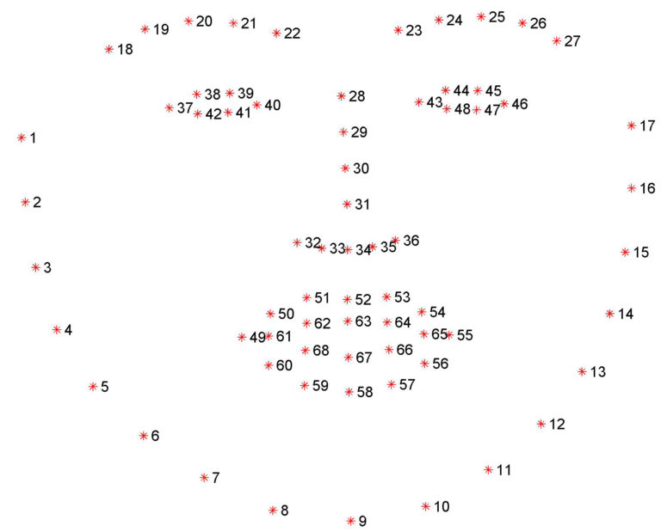
Principles Involved
Working
Figure : The full set of facial landmarks that can be detected via dlib
#HumseFarakPadtaHai www.road-safety.co.in

Slide 14
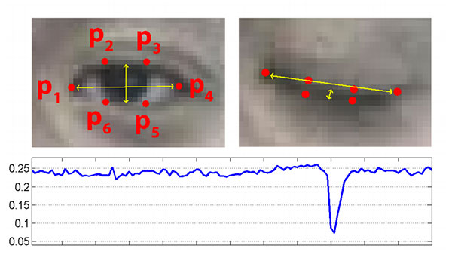
Principles Involved
Working
Figure : Top-left: A visualization of eye landmarks when then the eye is open. Top-right: Eye landmarks when the eye is closed. Bottom: Plotting the eye aspect ratio over time. The dip in the eye aspect ratio indicates a blink
#HumseFarakPadtaHai www.road-safety.co.in

Slide 15
Principles Involved
Working
On the top-left we have an eye that is fully open — the eye aspect ratio here would be large(r) and relatively constant over time.
However, once the person blinks (top-right) the eye aspect ratio decreases dramatically, approaching zero.
The bottom figure plots a graph of the eye aspect ratio over time for a video clip. As we can see, the eye aspect ratio is constant, then rapidly drops close to zero, then increases again, indicating a single blink has taken place.
We use this principle to detect drowsiness. If the EAR remains zero for some considerate amount of time, it’s an indication that the driver is sleeping and the alarm sets on.
#HumseFarakPadtaHai www.road-safety.co.in

Slide 16
Principles Involved
Working
For yawning detection, again we use the same technique. Instead of eyes aspect ratio, we have here mouth aspect ratio. If the MAR is above some threshold mark for some considerate amount of time, the alarm sets on and warn the driver even before he has closed his eyes.
We used Twilio library, for call and messaging the GPS location in case a accident has occurred.
#HumseFarakPadtaHai www.road-safety.co.in

Slide 17
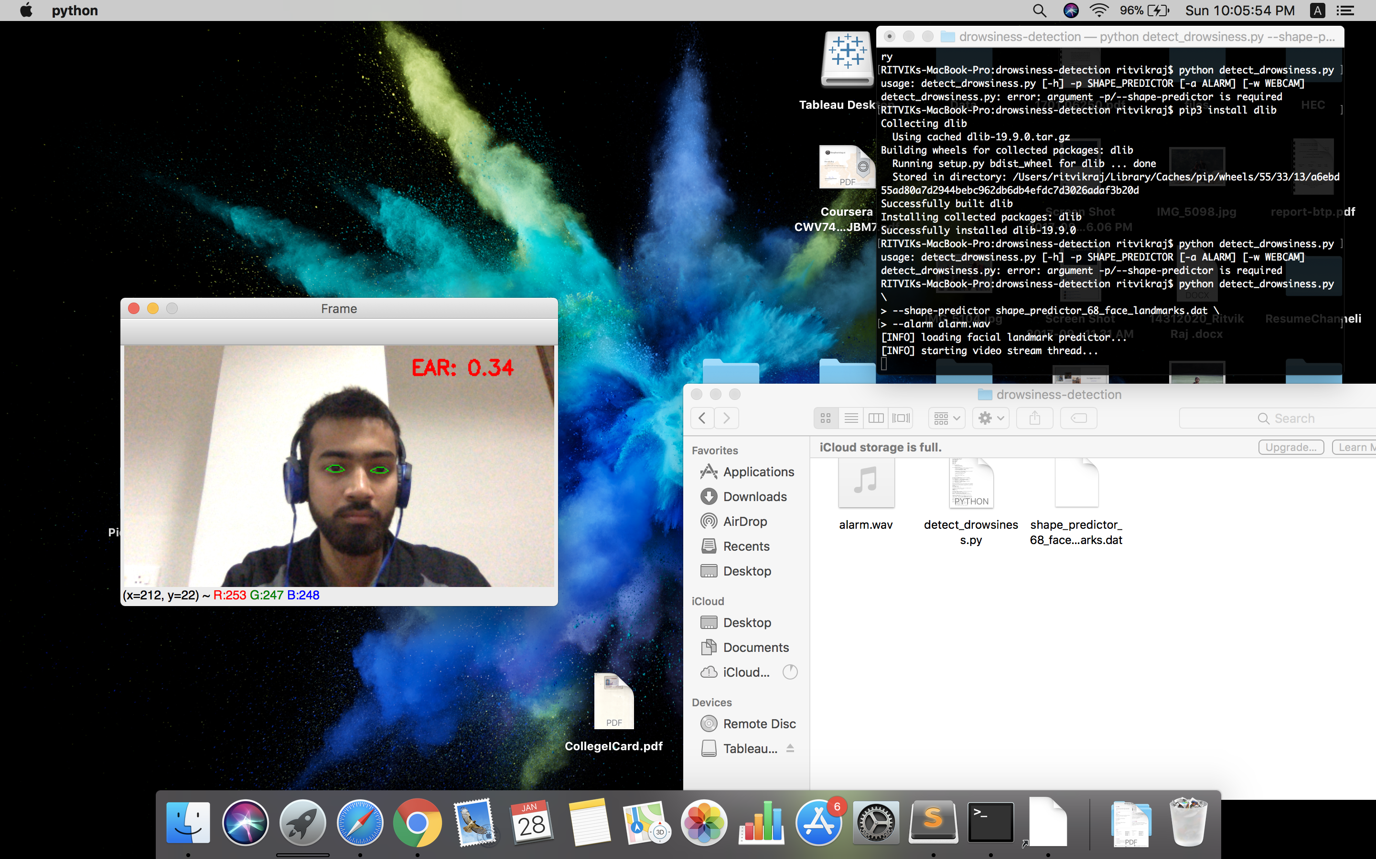
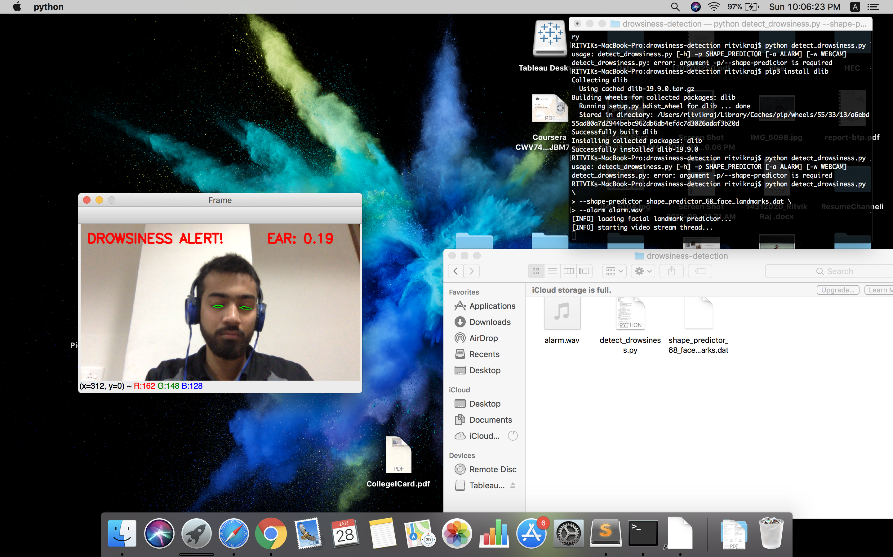
Demo
Working
#HumseFarakPadtaHai www.road-safety.co.in

Slide 18
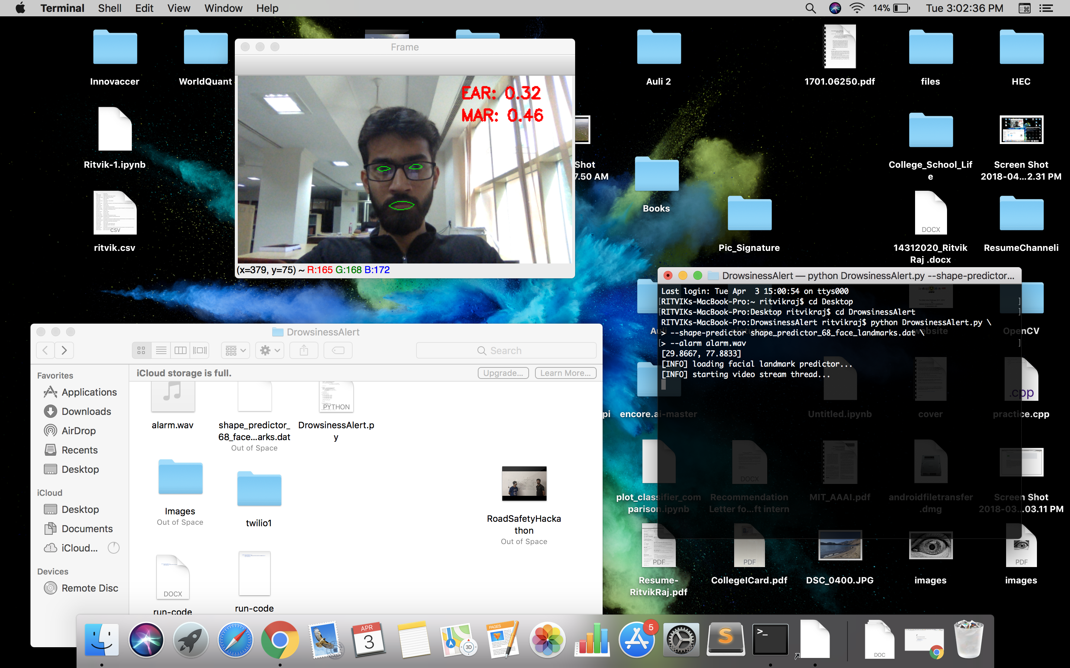
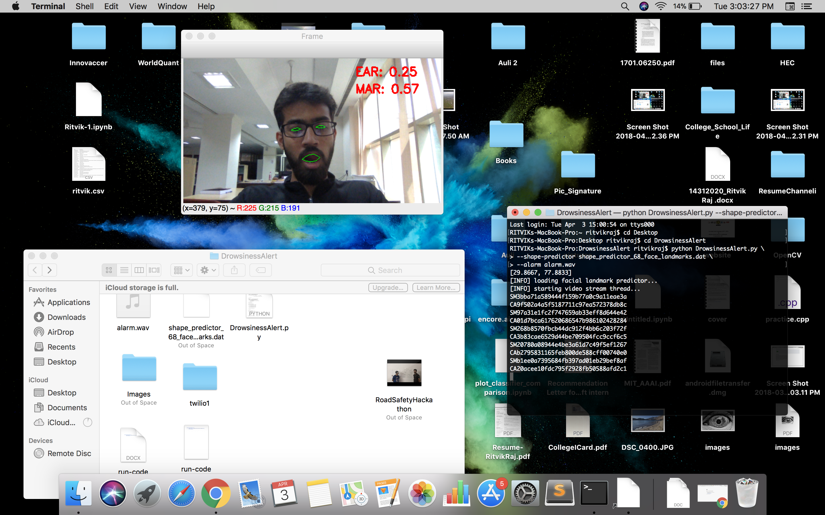
Demo
Working
#HumseFarakPadtaHai www.road-safety.co.in

Slide 19
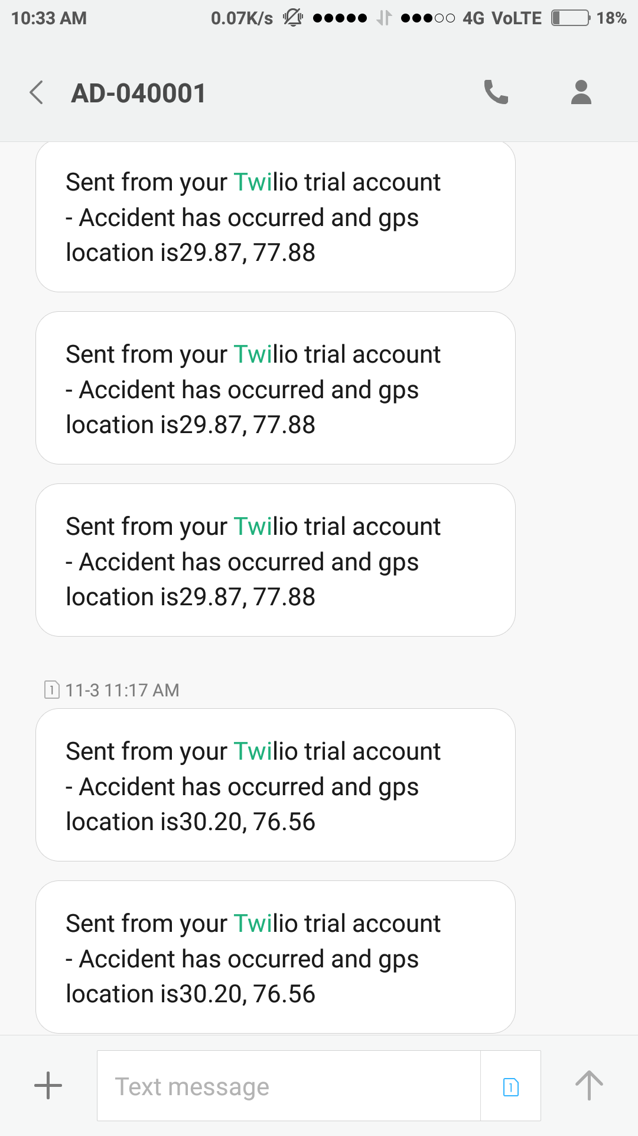
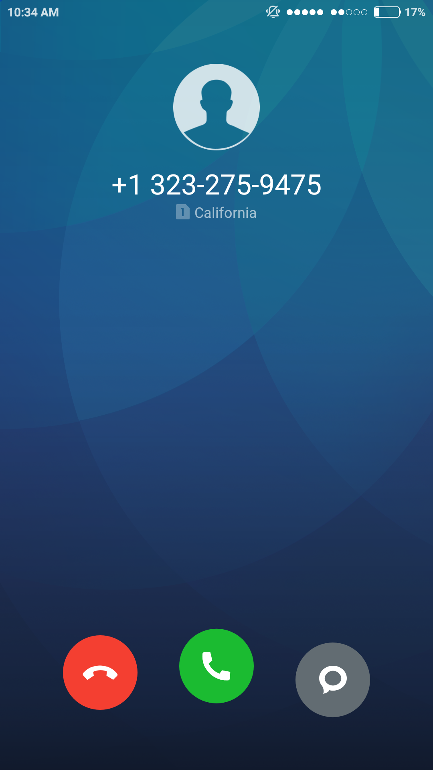
Demo
Working
#HumseFarakPadtaHai www.road-safety.co.in

Slide 20
Major Challenges Faced
What’s New
The main challenge was the implementation of eye detection algorithm to detect drowsiness in our application.
After that we added yawning detection and other features like messaging, calling and sending GPS location.
#HumseFarakPadtaHai www.road-safety.co.in

Slide 21
Future Prospect
Right now we are defining accident as closing of eyes for some considerate amount of time, but that isn’t enough. We will be adding some more feature to identify accidents in our app.
We want to make it more affordable to everyone, and so we are working on the mobile version of our application.
#HumseFarakPadtaHai www.road-safety.co.in

Slide 22
Learning Experience & Colclusion
It has been great working on this project.
We got more concern about drowsiness driving which doesn’t seem to be a big issue for a lot of people, but it really is.
Also we got to know about what are various government bodies all over the are doing in order to avoid or minimize drowsiness driving.
And lastly, we got to work on the application of Computer Vision and machine learning which has been really exciting for us.
#HumseFarakPadtaHai www.road-safety.co.in

Slide 23
Questions

Slide 24
THANK YOU!

Slide 25
GENERAL NOTES: 1. Keep it simple, informative as well as précised. 2. It is highly advice to modify the template but not to disturb the positioning of header and footers. 3. Improvise upon the overall slide. You are absolutely free to make changes. 4. This is just to facilitate the basic idea of the sample Presentation. 5. There is no limit to the number of slides. ALL THE BEST!

